Slide 1
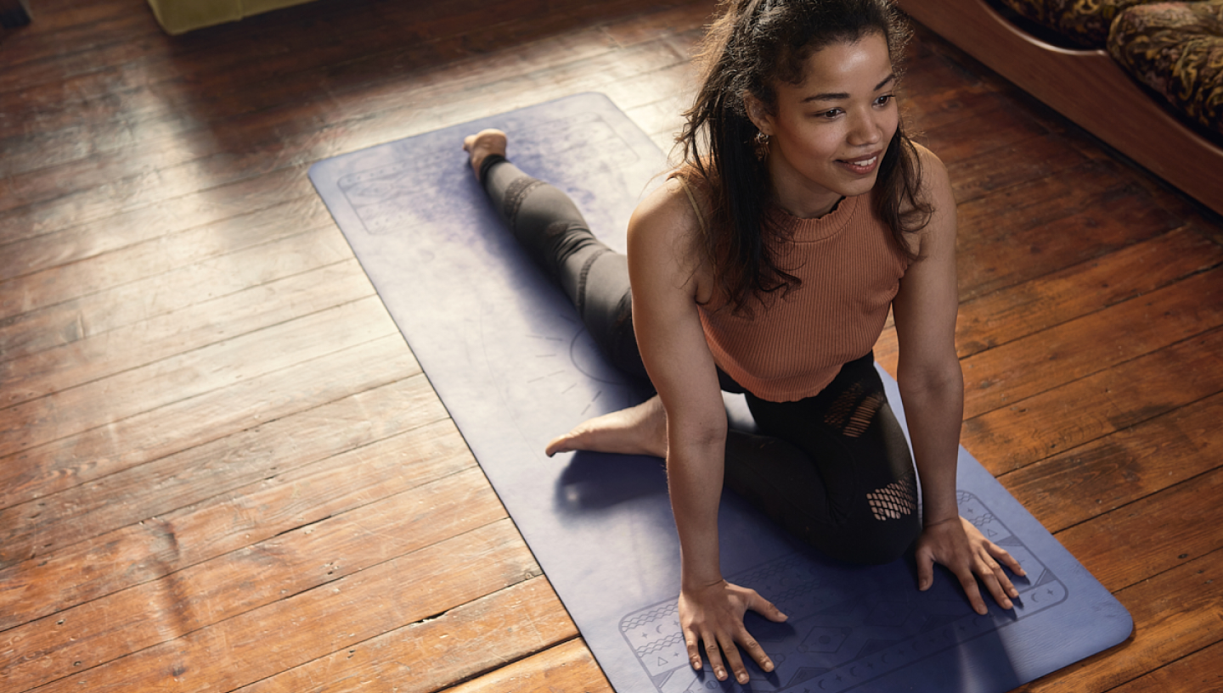




Your Culture and Values in Your Organisation
Buddle.co

Slide 2



Use this doodle box to try the annotation tools whilst you wait.
You can find the annotation tools on the right of your screen
Welcome.
Your session will begin shortly.
Before we start, please ensure that:
If you are using social media, please tag: #Buddle, @SportEngland @SportStructures
Your microphone is muted
You can see and use the chat box
Buddle.co

Slide 3


A little about me…
… and you!
Add Tutor Picture
Add some info about you in the chat box:
- Your Club/Organisation Name
- Where you are based
- What would you like to gain from this workshop?
- Insert name
- Insert Experience
- My favourite …
Buddle.co

Slide 4

Learning Agreement
Respect everybody
Participate actively
Use technology responsibly
Be engaged
Challenge each other positively
Put phones on silent and return calls at an appropriate time
Avoid sharing any personal/sensitive information outside of the session
Buddle.co
Notes:
Please ask learners to consent to the delegate agreement using the chat box/mic etc
Participate actively - contribute to discussions and activities
Use technology responsibly - turning camera on, where possible, to build connections
Be engaged - limit distractions and maintain focus during the session

Slide 5
What we’ll cover:
By the end of this workshop, you will be able to:
Investigate good values and culture for your organisation
Examine how culture can support local activity
Evaluate your use of values and culture to support your organisation in developing activities
Buddle.co

Slide 6


Slide 7
Values
Definition
“The regard that something is held to deserve; the importance, worth, or usefulness of something”
"your support is of great value“
Principles or standards of behaviour; one's judgement of what is important in life
"they internalize their parents' rules and values"
Buddle.co

Slide 8
Understanding values – whose is whose?
Passion Integrity excellence togetherness
Fairness Respect Care Honesty
Collaborative Ambitious Inclusive Innovative
Personal liberty, democracy and the rule of law
Integrity, behaviour and good business practices
Joyful passionate nurturing
Performance Passion Integrity Diversity
Excellence Innovation Customer Fixation Teamwork Community Fun
Buddle.co

Slide 9








Understanding values – whose is whose?
Passion integrity excellence togetherness
Fairness Respect Care Honesty
Collaborative Ambitious Inclusive Innovative
Personal liberty, democracy and the rule of law
Integrity, behaviour and good business practices
Joyful passionate nurturing
Performance Passion Integrity Diversity
Excellence Innovation Customer Fixation Teamwork Community Fun
Passion Integrity excellence togetherness
Fairness Respect Care Honesty
Collaborative Ambitious Inclusive Innovative
Personal liberty, democracy and the rule of law
Integrity, behaviour and good business practices
Joyful passionate nurturing
Performance Passion Integrity Diversity
Excellence Innovation Customer Fixation Teamwork Community Fun
Buddle.co

Slide 10

Breakout session
What are your organisations values?
How about your personal values?
Feedback from each room
Do these values matter to you or to your organisation?
How do you know?
Buddle.co

Slide 11
Breakout session
How does your organisation behave/not behave to live out their values?
Feedback from each room
Do you need to change anything?
If culture is behaviour, what do you need to do?
Buddle.co

Slide 12
Culture
The customs and social behaviors of a particular people or institution
The beliefs, values, and behaviors that are shared within a group, such as a religious group or a nation.
Culture includes language, customs, and beliefs about roles and relationships.
A culture is a way of life of a group of people-the behaviors, beliefs, values, and symbols that they accept, generally without thinking about them
Buddle.co

Slide 13
Some culture theory* - why join?
To be accepted
To feel part of a ‘family’
For a sense of identity
For respect
Because siblings or other family members are involved
Peer pressure
Cultural identity
Boredom
They think its attractive and cool
For other rewards
*Thurrock.gov.uk
Can you use cultural change to change organisation culture?
Buddle.co

Slide 14
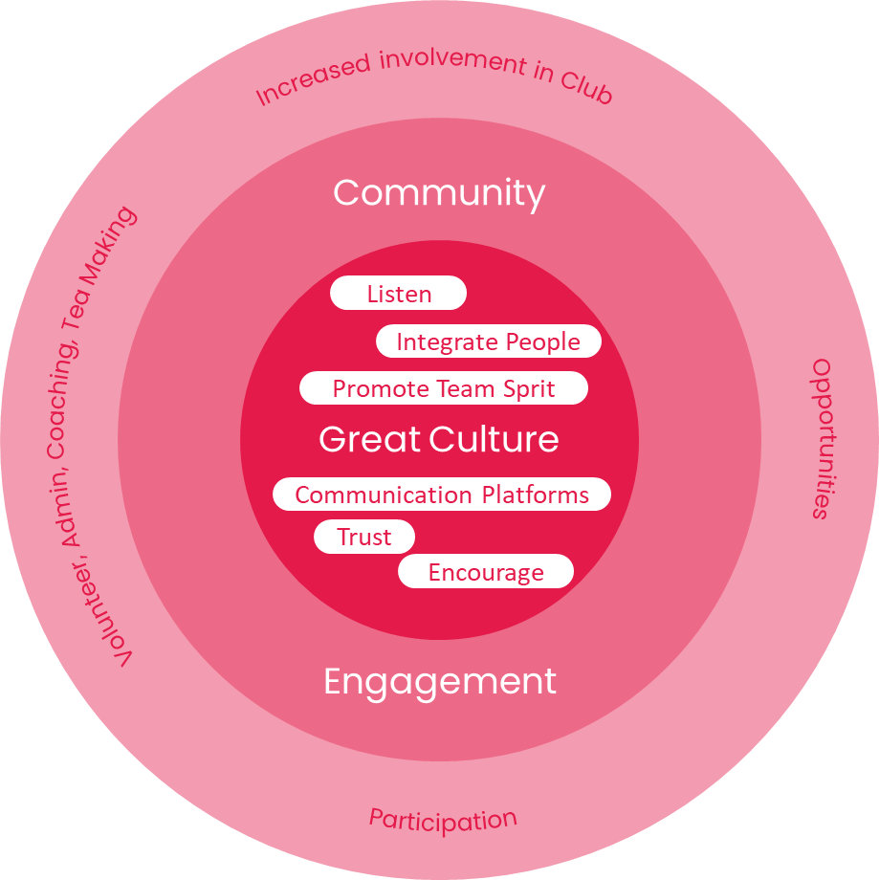
Culture concepts linked to your community organisations
Buddle.co

Slide 15
Culture is everything
Model great culture at all times
Use culture development to help with organisation issues
Engage organisations and members on culture and encourage discussions/challenges
If you and your organisations can articulate it, we can build it
Buddle.co

Slide 16
Culture
Artefacts
Behaviours
Values
Beliefs
What is your culture?
What sort of experience do you provide to your participants?
Buddle.co

Slide 17






Have you thought about?
How open your messaging is?
How welcoming are you?
What your participant's motivations are?
How inclusive you are?
What your participants need?
Your communications
Buddle.co

Slide 18
Organisation Culture
How do you create a welcoming and inclusive culture for your participants?
Is your approach organisation centric or participant centric?
Buddle.co

Slide 19


Breakout – Your Organisations
What problems do your organisation need to address?
How can culture development help with addressing them?
Feedback and shared notes on using culture change to help address a organisation problem
Buddle.co

Slide 20
Action Planning
What is our culture like now?
What do we want our culture to feel like?
How are we going to do it?
Buddle.co

Slide 21
Make it easy
Make it realistic
Make it fun
Make it inclusive
When developing your culture…
Buddle.co

Slide 22


Reflection
What will you take away from this session?
Any questions?
Please complete the evaluation
Good luck!
Buddle.co

Slide 23
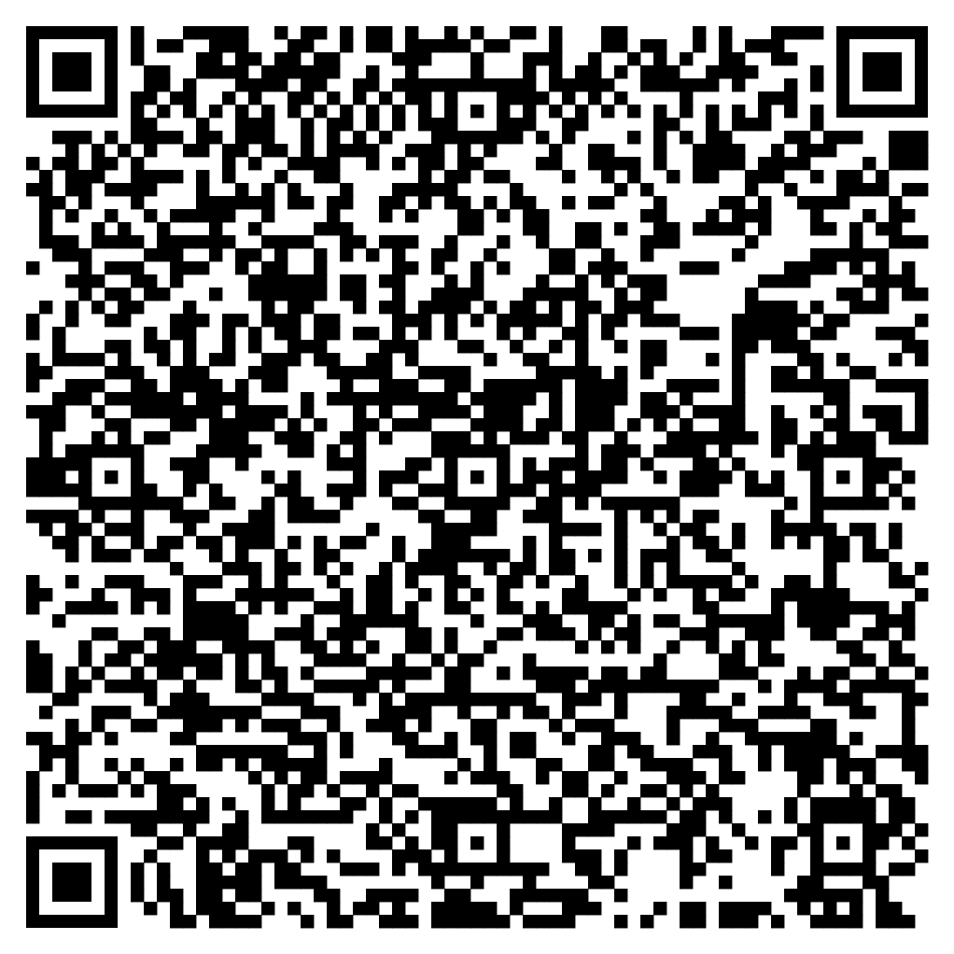





Feedback
Please take the time to fill in the evaluation survey by scanning the QR code.
Alternatively, the tutor will put the link in the chat box for you.
- Thanks in advance, the Buddle Team.

Slide 24
Recap:
By the end of this workshop, you will be able to:
Investigate good values and culture for your organisation
Examine how culture can support local activity
Evaluate your use of values and culture to support your organisation in developing activities
Buddle.co

Slide 25

Buddle training
Getting Organised | Inclusion | Getting Help From People | Money Matters | Develop and Grow
Leadership and Your People | Your Culture and Values In Your Organisation | Maximising Your Volunteers Experience | Raising Money to Sustain Your Organisation | Promoting Your Offer Using Social Media
Exploring Legal Structures | Engaging different People |  | Financial Management | Creating a Marketing Strategy
Simply Planning | Positive Experiences For All People |  | Dealing With Increasing Costs | Engaging your community
See future dates at www.Buddle.co

Slide 26


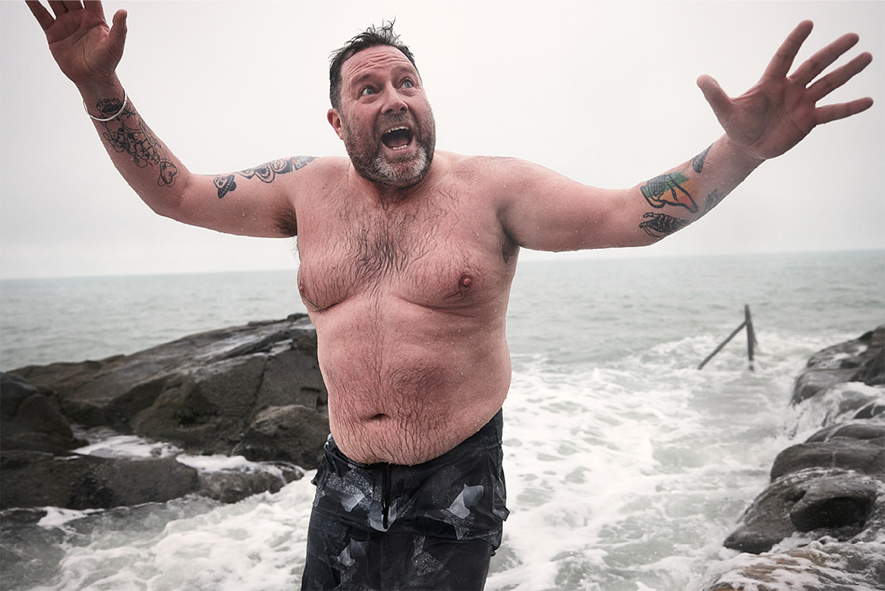
Thank you!
Buddle.co
Notes:
Title box: Click and drag the title box to resize, to allow for longer headings, or to fit around important areas of the image.
Image: To change the image, Right click / Control click on the image, select ‘Change picture… from file’.
Changing colours: Select the colour border area and apply a new shape fill from the Sport England Theme colours (please do not use the tints). Use the same colour for the border and the main title of the presentation.
Changing colours: Right click / control click the background, Select ‘Format background…’ Select a different fill colour from the Sport England Theme colours (please do not use the tints). Use the same colour for the border and the main title of the presentation.

