Slide 1
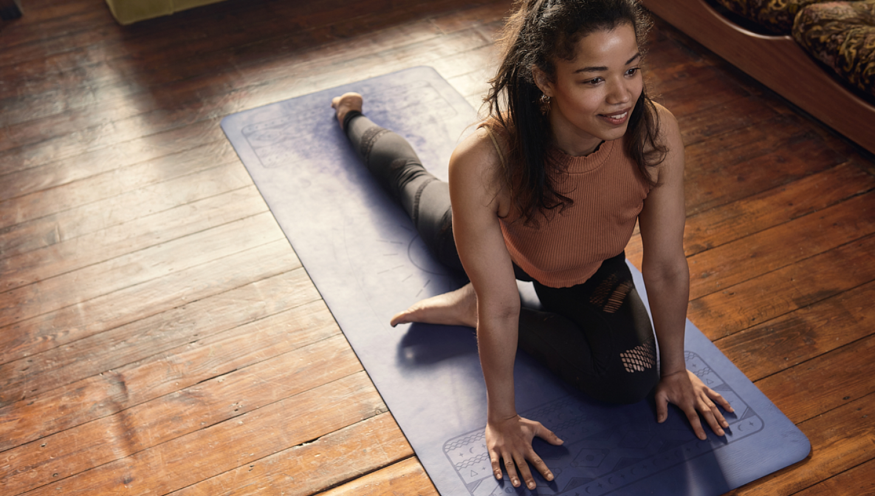




Creating an Inclusive Environment
Buddle.co

Slide 2



Use this doodle box to try the annotation tools whilst you wait.
You can find the annotation tools on the right of your screen
Welcome.
Your session will begin shortly.
Before we start, please ensure that:
If you are using social media, please tag: #Buddle, @SportEngland @SportStructures
Your microphone is muted
You can see and use the chat box
Buddle.co

Slide 3


A little about me…
… and you!
Add Tutor Picture
Add some info about you in the chat box:
- Your Club/Organisation Name
- Where you are based
- What you would like to gain from this workshop?
- Insert name
- Insert Experience
- My favourite …
Buddle.co

Slide 4

Learning Agreement
Respect everybody
Participate actively
Use technology responsibly
Be engaged
Challenge each other positively
Put phones on silent and return calls at an appropriate time
Avoid sharing any personal/sensitive information outside of the session
Buddle.co
Notes:
Please ask learners to consent to the delegate agreement using the chat box/mic etc
Participate actively - contribute to discussions and activities
Use technology responsibly - turning camera on, where possible, to build connections
Be engaged - limit distractions and maintain focus during the session

Slide 5
What we’ll cover
By the end of this workshop, you will be able to:
Identify the barriers people face in accessing opportunities as participants and volunteers in a community organisation
Understand the need for positive action
Outline the components of an inclusive community organisation
Identify how your community organisation can create a more positive environment that would enable a diverse range of people to be engaged and retained as participants and volunteers
Notes:
Tutor guidance: mandatory slide
Title: Objectives
Timing: 2-3 mins
Type of Activity: Presentation
OBJECTIVE – let people know what is coming.
At the end of this slide the workshop should be no more than 10 mins in.
Talk through each of the sections briefly. When discussing tutor to highlight its not a case of thinking of each type of group as a tick box i.e. must tick off disabled people, women etc, but thinking more generally, about how the club can create a more positive environment for all. Tutor to introduce here the principle of Intersectionality and that really it is all about including people, and anyone of us and any potential new member could face multiple barriers because of their background, experience or circumstances. No one person is defined as one thing, every person has a number of attributes to consider – many of which can’t be seen.
Introduce the workbook which is a resource for during the workshop and a tool to use with their club committee.

Slide 6
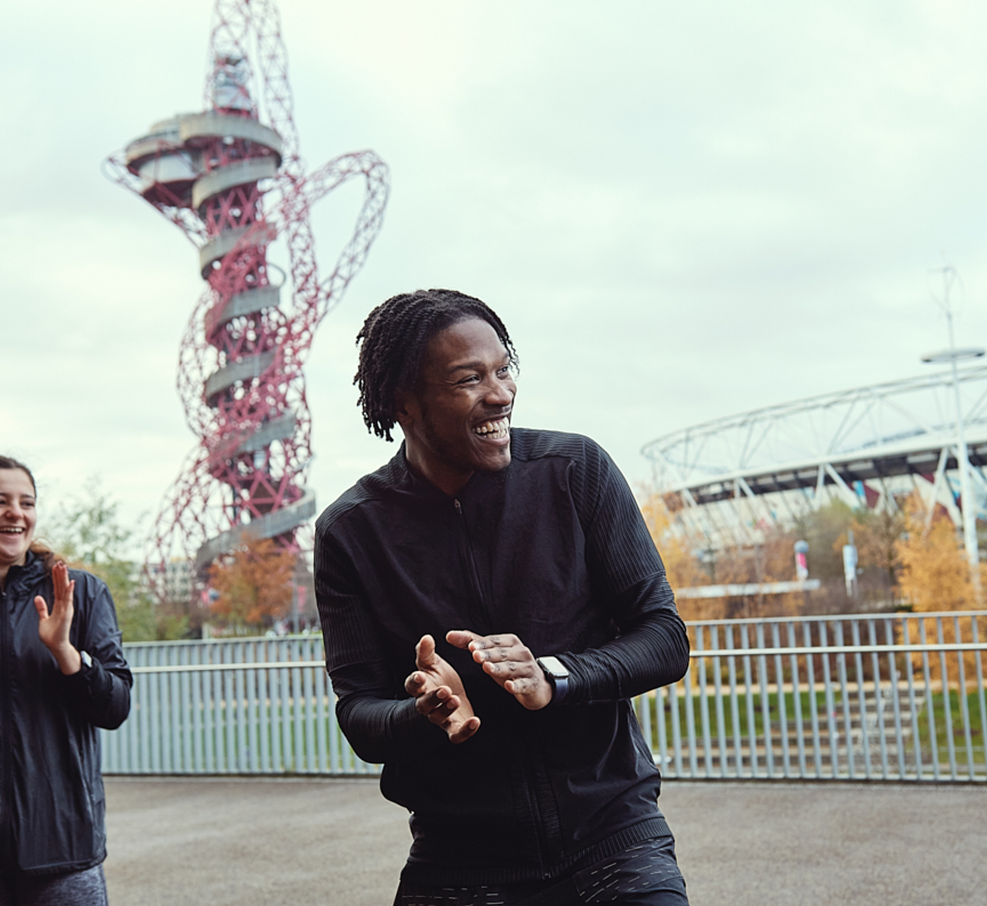
Why is this important?
  Your time to share:
  What does “Inclusive” mean to you?
  Why would this approach benefit your organisation?
  Who do you want to reach that you currently don’t?
Notes:
(13 mins) Objective: Delegates to understand the need and relevance for their club.
Tutor to use breakout rooms in threes for 8 minutes to explore these questions. As they return encourage them to share their feedback using shared notes like a market place and provide two people the opportunity to feedback any interesting discussions.
Tutor to start to lead into next slide by getting them to consider the benefits of this approach.

Slide 7





What are the benefits of this approach?
Attract and retain more people
Widen your talent pool
New ideas and perspectives from peoples lived experiences
Enhance your reputation
Build stronger links with your local community
Increase your income
Create new funding opportunities
Notes:
(5 mins) Objective: Delegates to understand the potential benefits of this approach
Tutor to start to lead into Club & community slide.

Slide 8
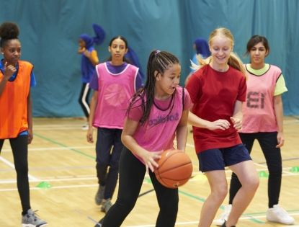
Your Organisation
1. Who is your
organisation community?
2. Are you representative of the local community?
3. Does your organisation feel part of the local community?
4. Does your community feel that your organisation is accessible to them?
5. Who are your community influencers?
Notes:
(4 mins) Objective: Delegates to consider that to be a club for everyone they need to consider if they are representative of their community and do they serve them.
Summary talk through slide to enable the tutor to pose the question to attendees if they are representative of their community? Do they know the local demographics – if not get them to research their local area and signpost to Active Partnerships who could support them to understand this a bit better. Are you a club that’s location is more about what the facility enables the club to do or do you serve the community? For example, a club may be based in a ethnically diverse area but the majority of members are white. Do you have a definition of your local community? We know for some sports the catchment might be a small radius around an estate or it might be a large catchment because of the specialist facility or activity. This is fine, but do you know who your community are and are any people locally excluded by accident? Do you recruit from the local community – do you feel part of it? Do you have links with local community influencers that can help you engage better with your local community such as local religious leaders or non sport community organisations.
Tutor can highlight the Club Matters Engaging your Community workshop here for more support. Great opportunity for the tutor to also highlight the wonderful stories of how many clubs supported there clubs beyond sport in the Pandemic and the opportunity that community engagement bring.

Slide 9
Are we proactive?
“You can’t join our organisation because…”
“Our doors are always open… we never turn anyone away”
“We have acted to make our organisation accessible to those who otherwise find it hard to take part”
1
10
Proactive Continuum
Notes:
(6 mins) Objective: Delegates to understand the need for positive action and to reflect on where their club sits along this continuum
Tutor to pose the question of how proactive are our clubs in addressing inequalities. Highlighting there is a continuum from being discriminatory at 1 end to positive action. Really ensure that we across the fact we want them to honestly look at this and understand it and then realise that the first one is discrimination – even if indirect or unintentional it is still discrimination. Tutor can ask the delegates to use the annotation tool to reflect and consider with honesty where their club sits on the continuum, ensuring they feel they are in a safe space and no-one is judging them to do this. Tutor may also highlight their own experiences of working with clubs and how a lot of clubs are probably in the equality neutral box, but how can they reach and support people that face barriers if they are not proactive in doing so. We totally appreciate that running a club in itself is a big task and simply doing nothing but not being proactive is an inactive position. Equality is about fairness but not about doing the same thing for everyone. Some people need additional encouragement or support to join your club, therefore by saying your doors are always open and you never turn anyone away – that might not be enough for some people to join.
The tutor may also relate this to the notion of being racist, non racist and anti racist.
Tutor to highlight that there is an activity in the resource that they can do with their club committee to have some interesting debate about where there club is now on this continuum. Tutor to make sure they feel ok to be honest and appreciate that it is difficult to consider this especially when we know how hard it is to run a club. Also acknowledging that there may be different opinions in the club committee about where there club sits and wants to sit in the future on this continuum.
Tutor can ask the question here – is it ok to be equality neutral? And create some debate. Steer attendees to consider how they can move their club towards positive action.

Slide 10

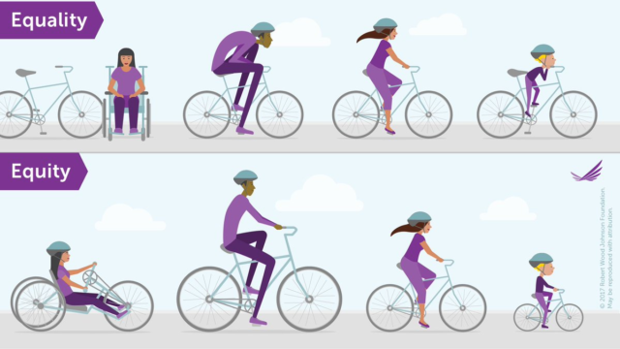
What are we trying to achieve?
Image source Robert Wood Johnson Foundation (@RWJF)
Notes:
(2 mins) Objective: Delegates to understand the need for positive action and inclusion
Tutor to follow up the key points from the previous slide with this illustration as a visual aid.
At the top of this image is a sport that might say it is achieving equality – it isn’t turning anyone away, it is providing equal opportunities but isn’t really enabling people with different needs to take part. What we are looking at with positive action is enabling everyone to do sport but that requires us to adapt and meet people’s needs. Such as a handicycle for the wheelchair user and a size bike appropriate to age and build.
DISABILITY IS A WIDE RANGE OF IMPAIRMENTS – NOT ABOUT EQUIPMENT IT’S THE APPROACH

Slide 11
Include ME!
1
Reach Me
2
Hear Me
Think of the social power of your community organisation and how it can make a difference to me
3
Welcome Me
4
Support Me
5
Value Me
6
Keep Me
Notes:
(20 mins) OBJECTIVES – Delegates to understand this is about people and including them in your club with a 6 stage model.
Tutor to summarise with the social power of clubs, how they can help make a real difference to people’s lives such as mental well being as well as physical health. Remind them they do a great job, but can they help more people by including them.
Tutor to then introduce the persona cards of Saffy, Tamara, Ory and Fred in the resource. Use breakout rooms for 10 minutes to get them to look at 1 or 2 of these personas and to consider what barriers they face and how they would include them with the 6 steps of Include Me.
Feedback to follow – the tutor can use the persona cards as slides for discussion. Feedback for 10 minutes max.
Comfort break for no more than 5 mins after this section

Slide 12
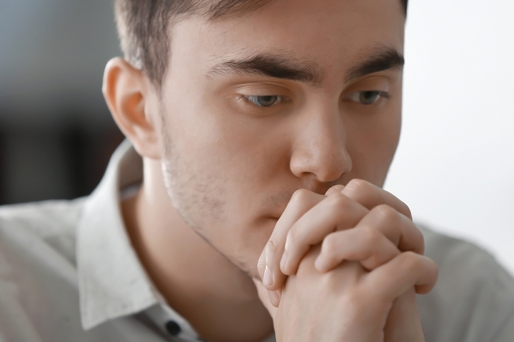
My name is Joe
“Sport has always been my life and I had big ambitions. But a year ago life started to spiral out of control, and I didn’t even really see it happening. I was diagnosed with Schizophrenia a few months later. It was the scariest time of my life. Now I am recovering well. I am on medication to control it, which make me a little slower than normal and despite the medication, I still have some symptoms. Part of my recovery is getting back into social settings and keeping active. Actually, I have found that this really helps. I worry though what people think of me…”

Slide 13
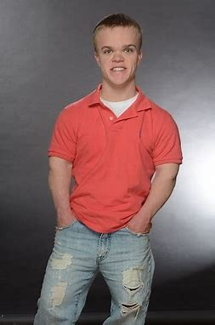

My name is Joe
“I am a fairly confident and intelligent person, but I am starting to struggle in life. I am a dedicated student but feel isolated amongst my peers. I was never included in PE lessons because of my Dwarfism. It’s not for someone like me.”

Slide 14
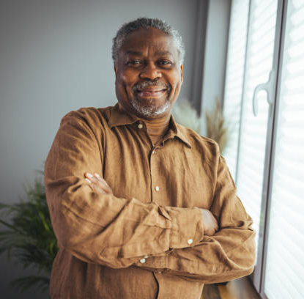
My name is Fred
“I live alone, sometimes feel lonely and more recently depressed. I have the love of my children, but they are fully grown and live far away. I am starting to consider my retirement. I am a little worried about my health, as I have been a smoker for 30 years. I have never been sporty myself but a big spectator. Love watching any sport on the tv. I always think I am better than the referees ... Haha.
Anyway, a colleague was talking to me about his boxing club needing people to help out. I am tempted but surely, I have nothing to offer. I wouldn’t have a clue where to start and can this old dog learn any new tricks?”

Slide 15

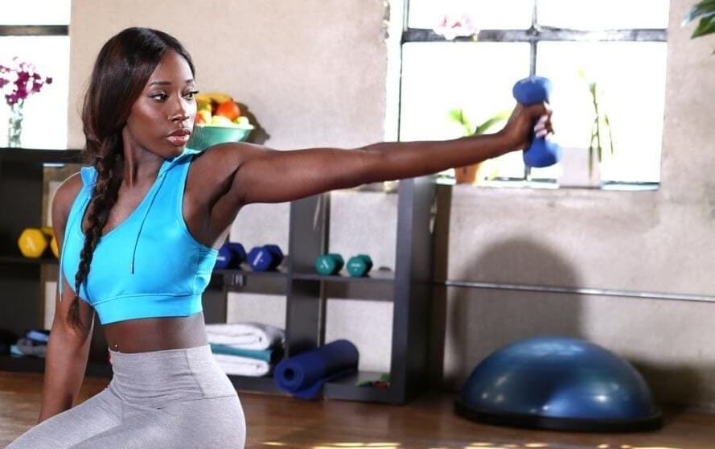
My name is Tonya
Call me “Miss Active”. I love being fit and healthy and I want to support and inspire others. I have recently trained as a Personal Trainer and love all sports. I have been applying for jobs and failing. They seem to love me on paper, but I think they can’t get past the fact that I am a bit different. Not sure if it is because I am black, a female, or deaf – or maybe all three.”

Slide 16

My name is Ory
“Hello, I am Ory, and I am 19 years old. I am an avid Football supporter and have been watching my team since I was little. It has only been recently that I have realised that it is ok to speak out and say how unhappy I am with the racism in the stands. When I was young my Dad just told me to ignore it and concentrate on the game and our team.
Over the years I have tried different sports, but always felt different to everyone else. I even think in one club that I was not selected because of the colour of my skin. I wish my football coach was more like me. This bad experience has meant I now no longer play the sport I love.”

Slide 17
Common barriers to Sports Participation
Psychological
Physical
Logistical
Notes:
(1 min) Objective: raise awareness of the different barriers people face accessing sport

Slide 18
Common barriers different people face
Psychological:
Personal perceptions of themselves.
Perception of others.
Perception of the sports club, facility or coach.
Created by:
Fear of / experience of discrimination
Lack of confidence / perceived lack of ability / body image
The ‘accepted’ face of sport
Assumptions
Attitudes of significant others
Perceived value in sport
Underrepresentation - lack of awareness of others ‘like me’ participating or volunteering in sport, a lack of role models
Lack of knowledge of sport or volunteering opportunities
Using the wrong terminology or language
1 in 8
LGBTQ+ people avoid going to gym or participating sport because of fear of decimation.
Notes:
(4 minutes). Objective: raise awareness of the different barriers people face accessing sport
Remembering every person will take each of these barriers in their own way, everyone is different, and some people face more than one barrier.
Tutor to explain that barriers can be grouped into 3 areas – Psychological, Physical and Logistical. Tutor to contextualise with examples and make it relevant for clubs. Bring it to life. Highlight that the Tackling Racism and Racial Inequalities in Sport Review found that racism and racial inequality still exist within sport in the UK and there are longstanding issues, which have resulted in ethnically diverse communities being consistently disadvantaged. Highlighted the importance of challenging racism and racial inequality and improving the representation of sport to be representative of society and our communities.
Stonewall
17 per cent of lesbian, gay, bi and trans people have experienced and 49 per cent have witnessed homophobia or transphobia in sport.
66 per cent of lesbian, gay, bi and trans people felt that there were problems with homophobia and transphobia in sport and that this acted as a barrier to LGBT people taking part.
One in eight LGBT people (12 per cent) avoid going to the gym or participating in sports groups because of fear of discrimination and harassment
https://outonthefields.com/media/

Slide 19
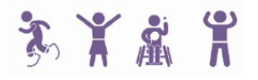
Common barriers different people face
Physical:
Lack of suitable opportunities.
Lack of awareness of facilities or activities
Lack of information or unable to find the right opportunity
Accessibility
Kit / equipment
No adaptations to activities
4 in 5
disabled people want to do more sport
Notes:
(3 minutes). Objective: raise awareness of the different barriers people face accessing sport
11.5 millions disabled people in the England (4 in 5 would be 8.8 million)

Slide 20
Common barriers different people face
Logistical:
Cost
Transport and location
Need for additional support
Time of activity and commitment requirement
Childcare
Poor communication and engagement
Cultural/religious beliefs and expectations – e.g. clothing, religious festivals, time for prayer, fasting and how this impacts on exercise etc.
PRICE
Low Income families have just £3.21 per week to spend on sports activities compared to the national average of £12.11.
Street Games
Notes:
(4 minutes). Objective: raise awareness of the different barriers people face accessing sport
Tutor to highlight that people often face a mix of all type of barriers not just 1 in this list, and not just physical or logistical or psychological – they are often interdependent.
As you get to the end of the barriers section it is worth highlighting the new Inclusion section (check when it is ready) of the website and the Online Presence quiz and toolkit for help in starting to address some of these barriers.

Slide 21
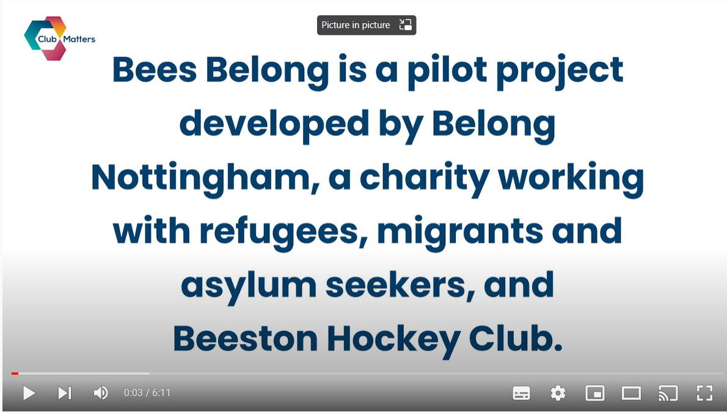
Break slide (10 minutes) bees belong video
Notes:
This video https://youtu.be/KnOw9fwAYhg could be put on during the break.

Slide 22
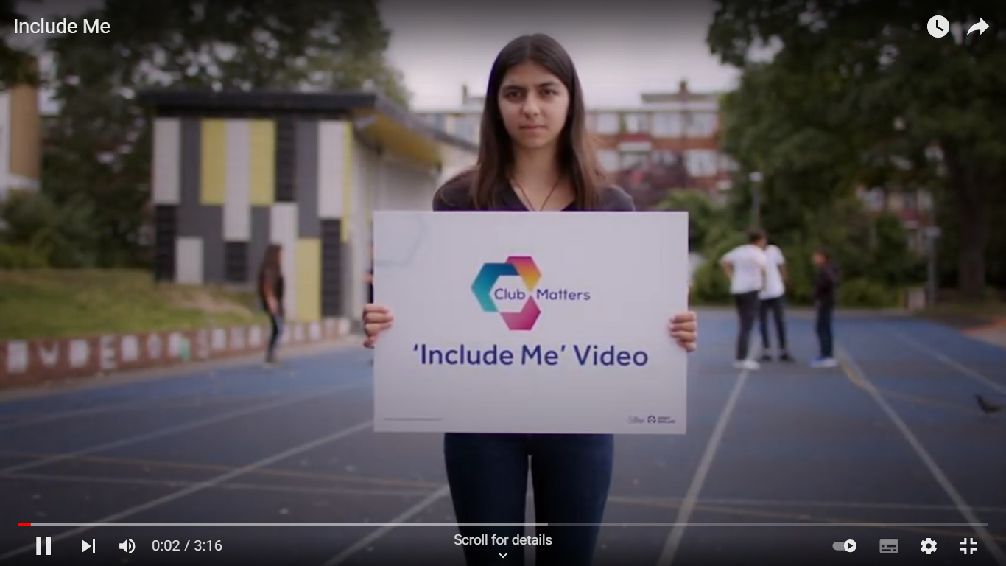
What does it feel like when we get it right and include people!
Notes:
(10 mins). Objective: Inspiration and awareness.
Tutor to show the video and then to allow people time to think, ask delegates to pop in the public chat a comment about the video. Does any of it resonate with them as a person, or make them think about what they do well already? Or even something that has made them think a little differently. Get the discussion on public chat to get as many people engaged as possible. If anyone feels comfortable they can come off mute and have a discussion about it.
Ideally we want to tutor to facilitate any great discussion around club culture – so that clubs don’t just think on pitch but think about it more widely about the feel of the club.
TUTOR NOTES – THE PEOPLE IN THE VIDEO WROTE THEIR OWN SLIDES?

Slide 23
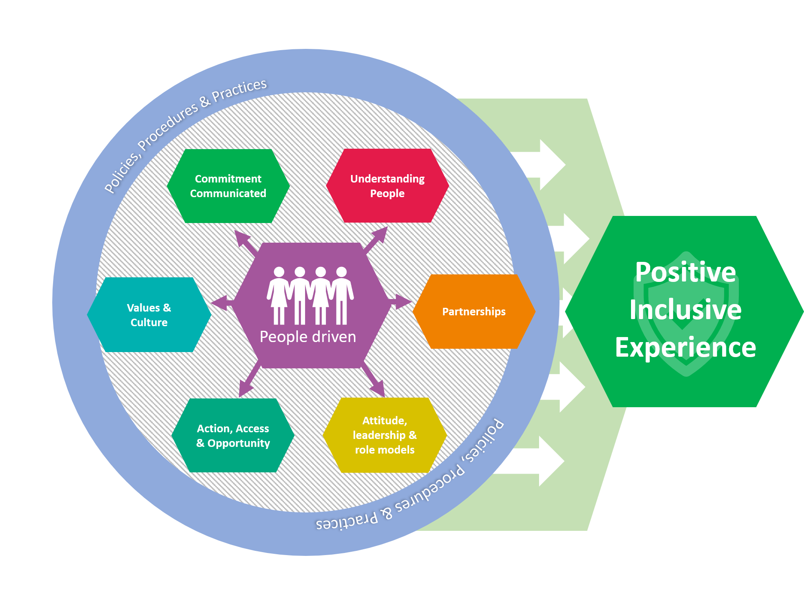
Positive environment for an inclusive organisation
Notes:
ANIMATION BEING DEVELOPED BY CONTINUUUM
(5 mins) –Objective: to outline the components required to be an inclusive club for everyone
Tutor to talk this through and engage conversation throughout – highlight it is a jigsaw and aims to help you work out what actions to focus on next that are appropriate for your club. We appreciate that every club may be at a different stage but each of these aspects enables the end result of a positive inclusive experience for all of your members – especially those harder to reach.
The best place to start is with your values and culture. A culture is a way of life of a group of people -the behaviors, beliefs, values, and symbols that they accept, generally without thinking about them, and that are passed along by communication and imitation from one generation to the next. (www.people.tamu.edu). Have a reflective view of your club and ask new members what they think of the culture of the club. Does this make people feel welcome? To drive an inclusive culture, think about your club’s values and how you want these values to become acceptable behaviors for all club members. What does your club believe in, what do you strive for, what are your values and how do these play out in action and behaviours. Are these supportive of a positive environment and inclusion? If you need to improve your culture this might take time, and that is ok. It also is interlinked with other key components such as your commitment, policies and leaders. Start with defining your values, and using this to create your club’s vibe.
Your organisation will need to state their commitment to equality, challenging inequality and inclusion, but this needs to be “real” and of value to your club and community, and therefore links to your values as well. This commitment should be communicated loud and clear, so everyone knows what you are trying to achieve and that you are a club for them.
To achieve a positive environment this needs to be led by your committee, coaches and volunteers and therefore they need to have a positive attitude and role model positive behaviours.
There needs to be a drive to understand people within their club and the people they don’t reach already. Appreciating that all people are different and valuing these differences. How can you ensure everyone has a voice in your club? Do you understand people’s motivations, interests, things they place importance on such as social activities or family time, and any potential barriers?
They need to be solution focused, understand the barriers people face and react with action to improve access and opportunity. Partnerships may be key in unlocking solutions and reaching people hard to reach.
Underpinning the components is the need for an Equality Policy
Tutor to highlight that all clubs are different and have different resources to consider. But every club should have an Equality Policy as a requirement of the Equality Act 2010. Equality is about ensuring equal opportunities, fairness and that no one is discriminated against regardless of age, disability, sex, gender reassignment, sexual orientation, race, religion or beliefs, pregnancy or maternity or marriage or civil partnership. But it is more than a piece of paper. Start with the commitment your club makes to equality and promote this commitment – make everyone know that it is important to your club. Your policy is important to look at what this means for your club in action and is supported by the processes. One big challenge for clubs is challenging negative behaviour and discrimination. Things that support this are Codes of Conduct. Bring it to life by including equality training for all club volunteers or coaches – even if its not formal but looking at what the policy means for the club.
Whilst there is the paperwork requirement with an equality policy and procedures, but this is more about your club’s approach and about people. Your people drive your values and culture and bring all the other components here to life.
Ultimately it all leads to providing a positive experience and including people. Striving for a club where every individual feels included, welcomed and their needs are met.

Slide 24
Future Action
Educate
Engage
Empower
Notes:
(15 mins) – Objective: to identify how their club can create a positive environment
Utilise the resource and the breakout rooms to answer some self reflection questions and look at ideas they can take back to their club to help them to be more inclusive. They can carry this on with the club committees. No feedback after this one.

Slide 25
How can your community organisation or sports club create a positive environment to include everyone?
Notes:
(15 mins) – Objective: to identify how their club can create a positive environment
Utilise the resource and the breakout rooms to answer some self reflection questions and look at ideas they can take back to their club to help them to be more inclusive. They can carry this on with the club committees. No feedback after this one.

Slide 26


Reflection
What will you take away from this session?
Any questions?
Please complete the evaluation
Good luck!
Buddle.co

Slide 27
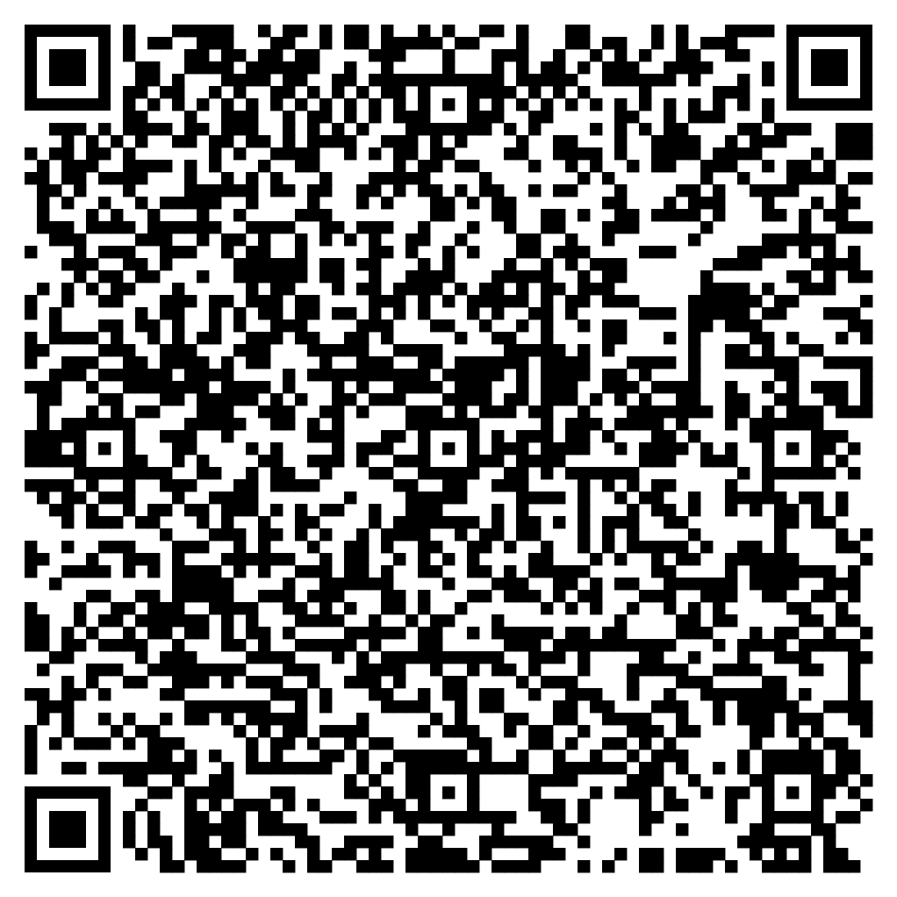





Feedback
Please take the time to fill in the evaluation survey by scanning the QR code.
Alternatively, the tutor will put the link in the chat box for you.
- Thanks in advance, the Buddle Team.

Slide 28
Recap:
By the end of this workshop, you will be able to:
Identify the barriers people face in accessing opportunities as participants and volunteers in a community organisation
Understand the need for positive action
Outline the components of an inclusive community organisation
Identify how your community organisation can create a more positive environment that would enable a diverse range of people to be engaged and retained as participants and volunteers.
Buddle.co

Slide 29

Buddle training
Getting Organised | Inclusion | Getting Help From People | Money Matters | Develop and Grow
Leadership and Your People | Your Culture and Values In Your Organisation | Maximising Your Volunteers Experience | Raising Money to Sustain Your Organisation | Promoting Your Offer Using Social Media
Exploring Legal Structures | Engaging different People |  | Financial Management | Creating a Marketing Strategy
Simply Planning | Positive Experiences For All People |  | Dealing With Increasing Costs | Engaging your community
See future dates at www.Buddle.co

Slide 30


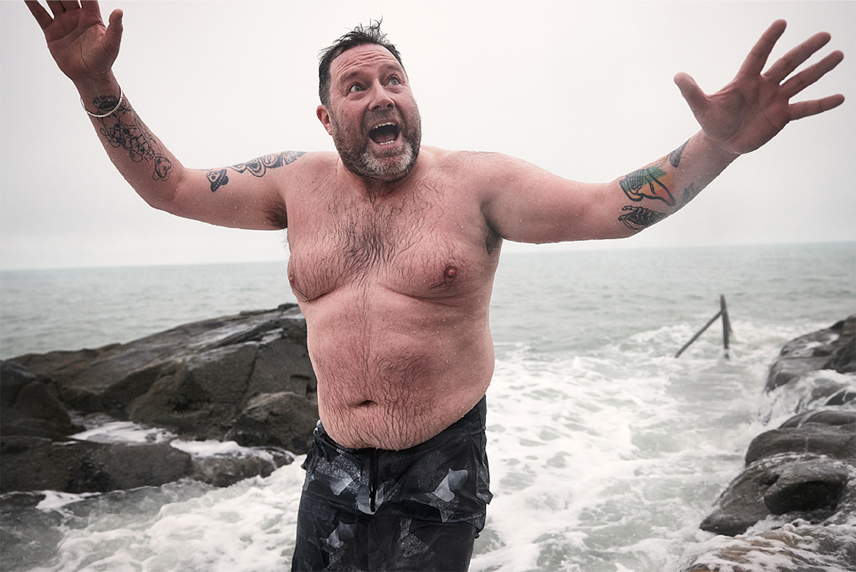
Thank you!
Buddle.co
Notes:
Title box: Click and drag the title box to resize, to allow for longer headings, or to fit around important areas of the image.
Image: To change the image, Right click / Control click on the image, select ‘Change picture… from file’.
Changing colours: Select the colour border area and apply a new shape fill from the Sport England Theme colours (please do not use the tints). Use the same colour for the border and the main title of the presentation.
Changing colours: Right click / control click the background, Select ‘Format background…’ Select a different fill colour from the Sport England Theme colours (please do not use the tints). Use the same colour for the border and the main title of the presentation.

