Slide 1
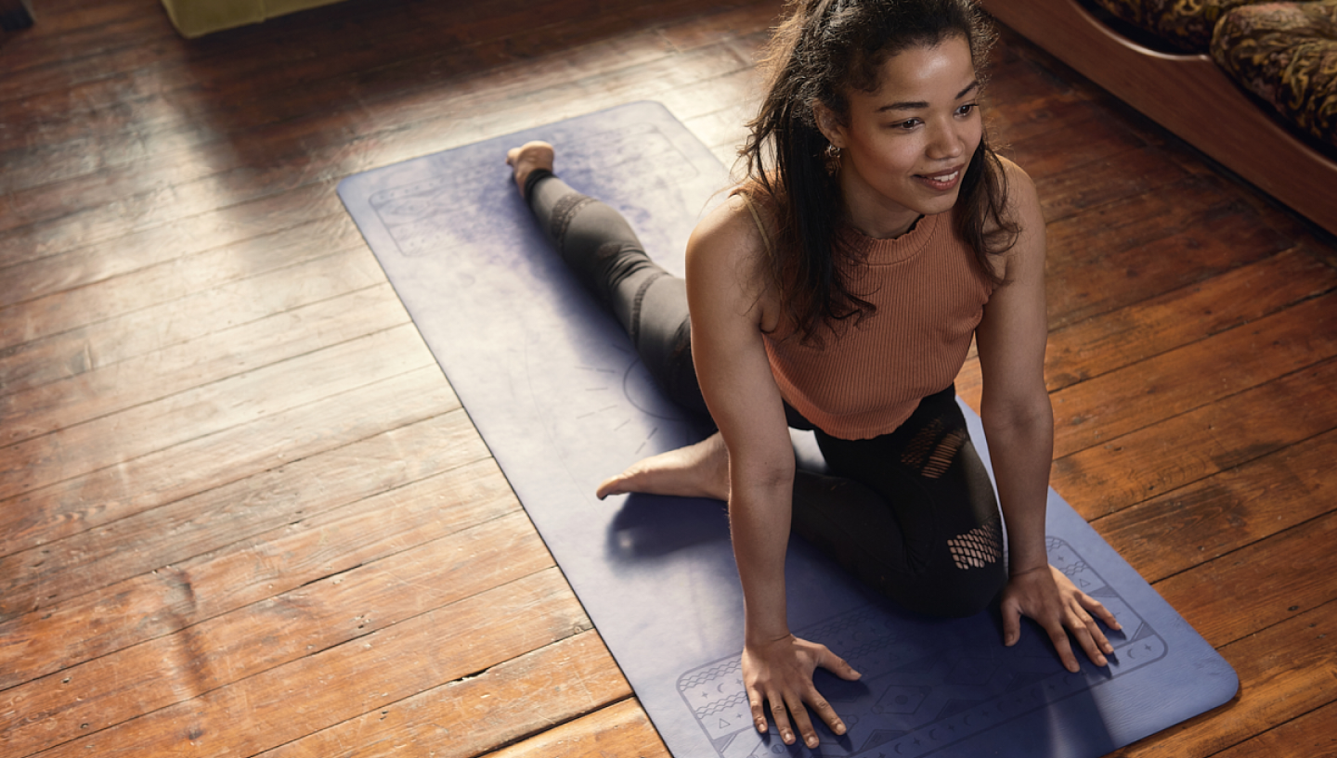




Using social media to promote your offer
Buddle.co

Slide 2



Use this doodle box to try the annotation tools whilst you wait.
You can find the annotation tools on the right of your screen
Welcome. Your session will begin shortly.
Before we start, please ensure that:
If you are using social media, please tag: #Buddle, @SportEngland
Your microphone is muted
You can see and use the chat box
Buddle.co

Slide 3


A little about me…
… and you!
Add Tutor Picture
Add some info about you in the chat box:
- Your Club/Organisation Name
- Where you are based
- What would you like to gain from this workshop?
- Insert name
- Insert Experience
- My favourite …
Buddle.com

Slide 4

Learning Agreement
Respect everybody
Participate actively
Use technology responsibly
Be engaged
Challenge each other positively
Put phones on silent and return calls at an appropriate time
Avoid sharing any personal/sensitive information outside of the session
Buddle.co
Notes:
Please ask learners to consent to the delegate agreement using the chat box/mic etc
Participate actively - contribute to discussions and activities
Use technology responsibly - turning camera on, where possible, to build connections
Be engaged - limit distractions and maintain focus during the session

Slide 5
What we’ll cover:
By the end of this workshop, you will be able to:
Understand the benefits of using social media in your organisation
Understand how to have a safe social media environment
Considered your brand and ideas for social media
Considered set up and analytics for social media in your organisation.
Buddle.co

Slide 6
What is social media and how can you use it?
Buddle.co

Slide 7
What is social media and how you can use it?
Social media refers to online platforms and websites that enable individuals to create, share, and participate in virtual communities and networks, exchanging ideas, information, and media content.
It’s reshaped the way we communicate, influencing opinions, driving social movements and engagement and connecting individuals with shared interests on a local, national and global level.
But how can you utilise its effects:
Foster community engagement
Showcase behind-the-scenes moments
Promote events
Build partnerships
Highlight achievements,
Make data-driven decisions for effective promotion and lasting connections with your audience.
Buddle.co

Slide 8
Statistics That Speak Volumes
In an era where digital presence is paramount, leveraging social media can significantly impact your engagement and participation rates.
Social media is not just for the young; it spans across age groups, making it a diverse and inclusive platform.
Over 4 billion people worldwide are active on social media, with some of the most popular platforms, Facebook, Instagram, Twitter, and LinkedIn collectively hosting billions of users every day. This makes Social media a perfect avenue for you to promote your offer to your targeted audience.
Buddle.co

Slide 9
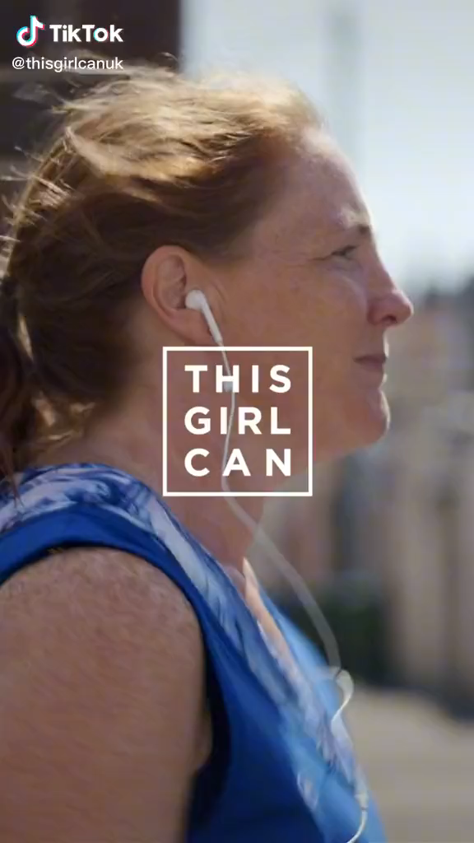
This Girl Can Campaign
‘This Girl Can’ launched in 2015 resulted in getting 1.6million women exercising.
The use of vibrant visuals and relatable stories on socials is not just fitness inspiration; it's a celebration of every woman's unique journey to fitness.
The campaign uses “real” people (as opposed to models or professional athletes), which makes it relatable, authentic and believable, with inspiring and relatable messages such as, “I’m slow, but I’m lapping everyone on the couch”, “Sweating like a pig, feeling like a fox” and “I also know the offside rule.”
Buddle.co
Notes:
https://www.tiktok.com/@thisgirlcanuk/video/6872294160787901698?lang=en

Slide 10
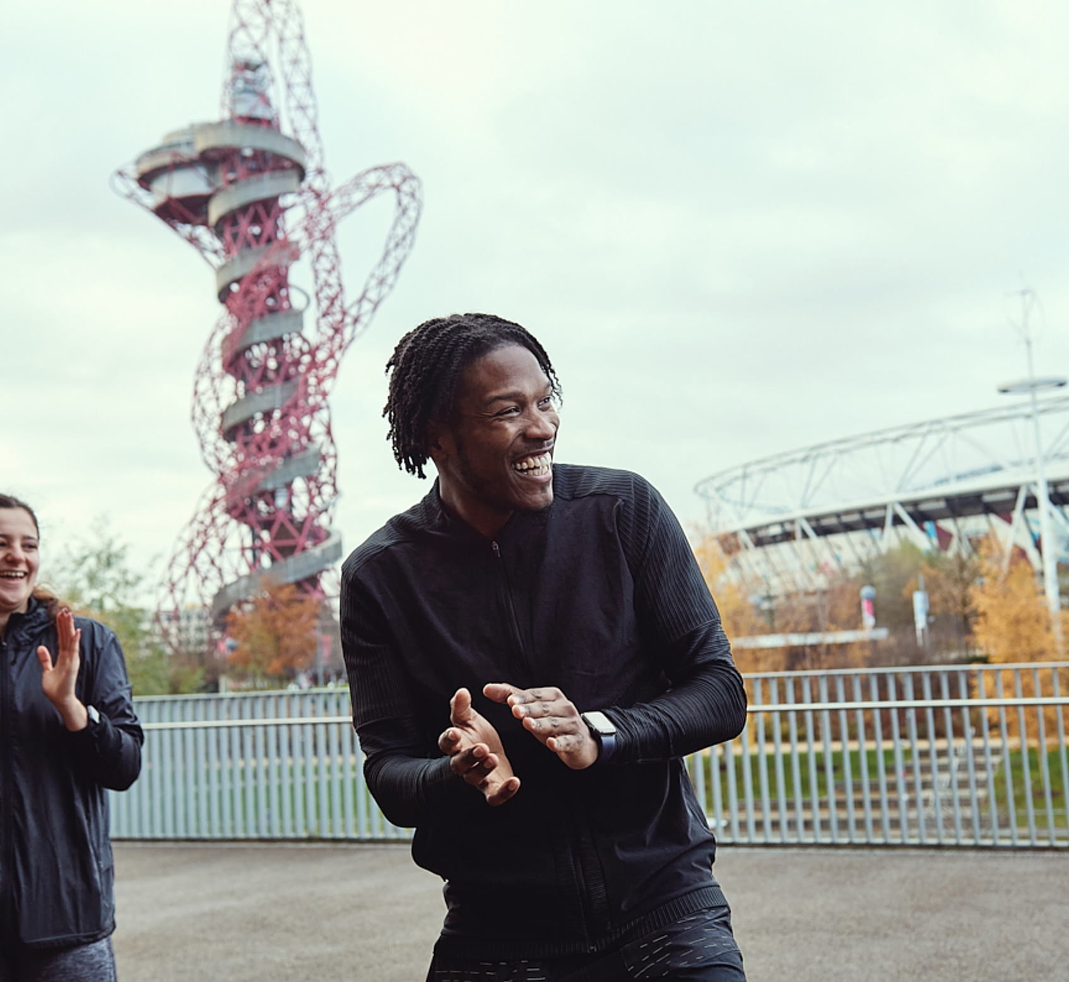
Considerations:
Before you get started you should think about what social media platform is right for your organisation. Consider:
How you want to use social media and what you want to achieve.
Which social media sites are the most popular with your target audience (e.g. members, parents, players, sponsors etc).
The resources you need, including who has the skills to manage your group's social media presence.
Buddle.co

Slide 11
Benefits for your organisation
“
Social media allows conversations to happen between your organisation and the people important to you, whether that's your members, volunteers, players, supporters, parents or sponsors.
Social media can add a more informal and personal touch to your marketing and by creating a strong online community, you will strengthen your organisation in the 'real' world.
Social media and social networking sites are accessible, quick, cost-effective and user-friendly once you get going.
You don’t need a corporation or a marketing company to brand you now: you can do it yourself. You can establish who you are with a social media following.”
Ray Allen, pro basketball player
Buddle.co

Slide 12
What are the risks?
Security
Human error such as posting confidential or sensitive information
Legal
Data protection and privacy
Reputational
Content must be reflective of the brand/image you want to portray
Inconsistency of posts, posts that can cause offence, dealing with negative feedback
Content
Online Safety Bill 2023
Buddle.co
Notes:
Security: Run training to educate vols on the dangers to look out for and what to do if they have made an error. Other security factors may include phishing attacks or scams.
Legal: GDPR and privacy policies are important to consider – how data will be stored and used.
Content: Inconsistency (tone, voice, style of content), posts that can cause offence (ensuring consent of those under 18), using social media tools to monitor feedback received on social media platforms to quickly identify feedback and address it before unwanted exposure.
Online Safety Bill 2023: Act to protect people, especially young people, from accessing harmful, inappropriate and distressing content online. Providers will be required to improve user safety and reduce the occasions where someone could access harmful content. Will be regulated by ofqual. More info to be released 2024. Clubs and community groups just need to have an awareness of it:
https://www.gov.uk/guidance/a-guide-to-the-online-safety-bill

Slide 13
What are the risks?
While social media provides excellent tools for helping you engage with members and the public, it can also present a number of risks such as:
Cyber bullying through posts which are upsetting and often inaccurate
Causing offence to individuals, or other clubs and organisations
Exposure to inappropriate content, or nasty comments and pictures
Developing a Social Media Policy and nominating a Social Media Officer are great first steps to being safe on social media.
Buddle.co

Slide 14
Safety first
Develop a social media policy
Developing a social media policy that sets out how it should be used and managed to protect your group and your members is a good place to start.
You don’t need to start from scratch, many of the behaviours and actions you would consider to be unacceptable in the 'real' world, are also unacceptable online. So, make your social media policy an extension of your code of conduct or use our template to get you started.
Nominate a social media officer
Decide who will have responsibility for the set-up, management and moderation of your social media.
Ensure they are suitably trained and aware of online safeguarding issues and support them by making sure the rest of your club are aware of your social media policy and their responsibilities online.
Buddle.co

Slide 15
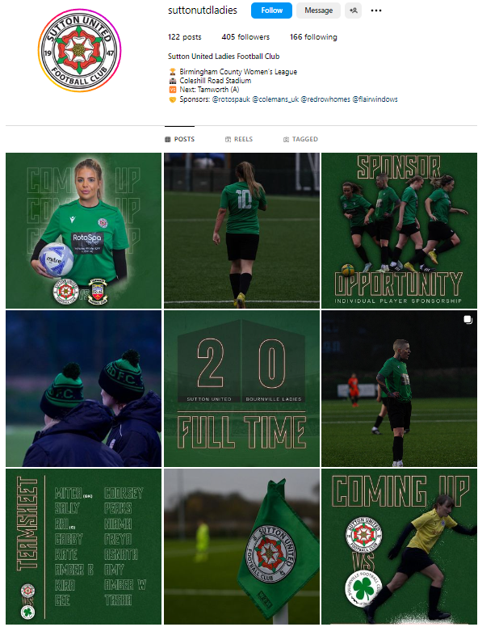
Sutton United Ladies
Sutton United are a prime example of a club account that excels in brand consistency, using team colours meticulously.
Highlights include regular posts on upcoming fixtures, ensuring fans stay engaged. Personal connections are fostered through birthday celebrations, acknowledging players of the match, and team achievements with Game pictures shared effectively to capture match essence for shareable content.
Beyond the pitch, the account shares glimpses of social events, adding a human touch. Strategic reveals of new sponsor kits generate anticipation, and announcements of a new home ground enhance the fan experience.
Buddle.co

Slide 16
Ipswich Town FC
As with any Championship football team, you would expect a substantial fan following, but Ipswich Town connect with their fans across a wide range of social media platforms including Twitter, Facebook, Instagram, YouTube and Google+. This lets them engage with all ages of social media users.
The Club ultise two twitter accounts, an official Twitter page for news, behind the scenes videos, fixtures, competitions etc and a second account that is used to promote and sell merchandise and tickets for games, in addition to retweeting fan’s tweets and pictures. This two-account approach ensures fans aren’t bombarded with promotion posts unless they choose to follow both accounts.
Buddle.co

Slide 17
Let's spend a few minutes looking at your brand on social media.
Who can access it?
How does it feel?
Is it serving a purpose?
Buddle.co

Slide 18
Let’s get creative, what ideas do you have for your social media brand?
Buddle.co

Slide 19







What is the best way to reach your target market?
88% of 18-29 year olds use Facebook
84% of 30-49 year olds use Facebook
72% of 50-64 year olds use Facebook
62% of 65+ year olds use Facebook
59% of 18-29 year olds use Instagram
33% of 30-49 year olds use Instagram
18% of 50-64 year olds use Instagram
8% of people 65+ use Instagram
36% of 18-29 year olds use X (formerly Twitter)
23% of 30-49 year olds use X
21% of 50-64 year olds use X
10% of 65+ year olds use X
Buddle.co

Slide 20
Social Media – Do’s and Don’ts
Do | Don’t
Be yourself, be original Disclose who you represent Participate regularly Be human and have fun (but remember it is a public record) Give credit to others Include links, photos and videos to keep things interesting Be friendly and show personality through your content Share business milestones – like you would with family / friends | Hog the spotlight– think 90% about others / big ideas / resources and 10% about you Share / retweet without knowing what you are “endorsing” Post too much – spamming people will turn people off Not post enough – try several times a week or daily: keeps interest Ignore it – your customers may well already be talking about you Just focus on the business and push out business content.
Buddle.co

Slide 21
Social Media – Top Tips
Identify ‘who’ you are targeting
Pick the right platforms
Post regularly
Link back to your website
Track results and adjust approach
Keep content light and relevant to the platform
Keep colors, fonts and tone of voice consistent
Respond to comments, messages and mentions
Experiment with scheduling times to see when your audience is most active
Buddle.co

Slide 22
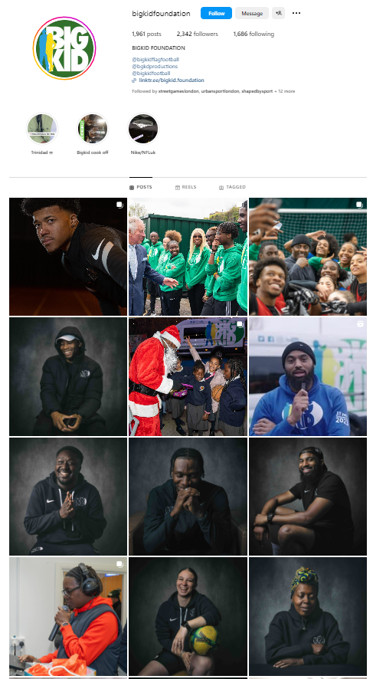
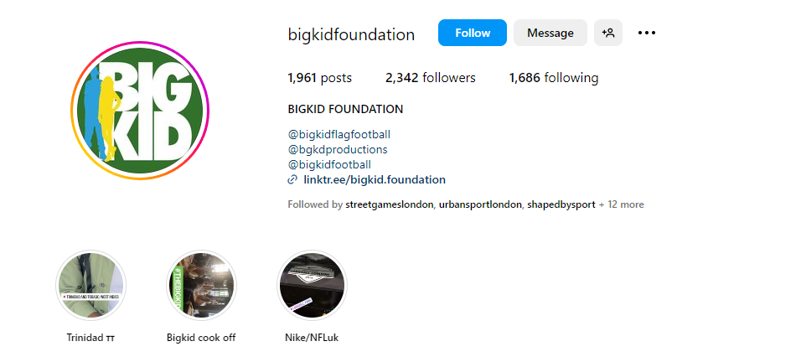
Good Practice Examples - Instagram
Posting stories gives real time engagement, allowing you to post behind-the-scenes look at your brand.
Clear Username so the account can be easily identified.
Adding additional social media account in your bio increases visibility, engagement and creditability.
Highlights featured at the top of a profile are a great way to drive attention to important content and projects, detailing your brand.
The use of a Linktree in your social media bio allows you to direct your followers to additional sites without them having to search, such as your website or YouTube channel.
Buddle.co
Notes:
https://www.instagram.com/bigkidfoundation/

Slide 23
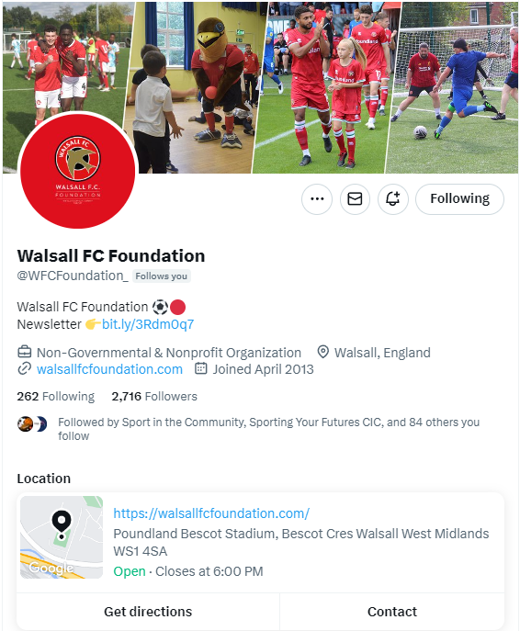
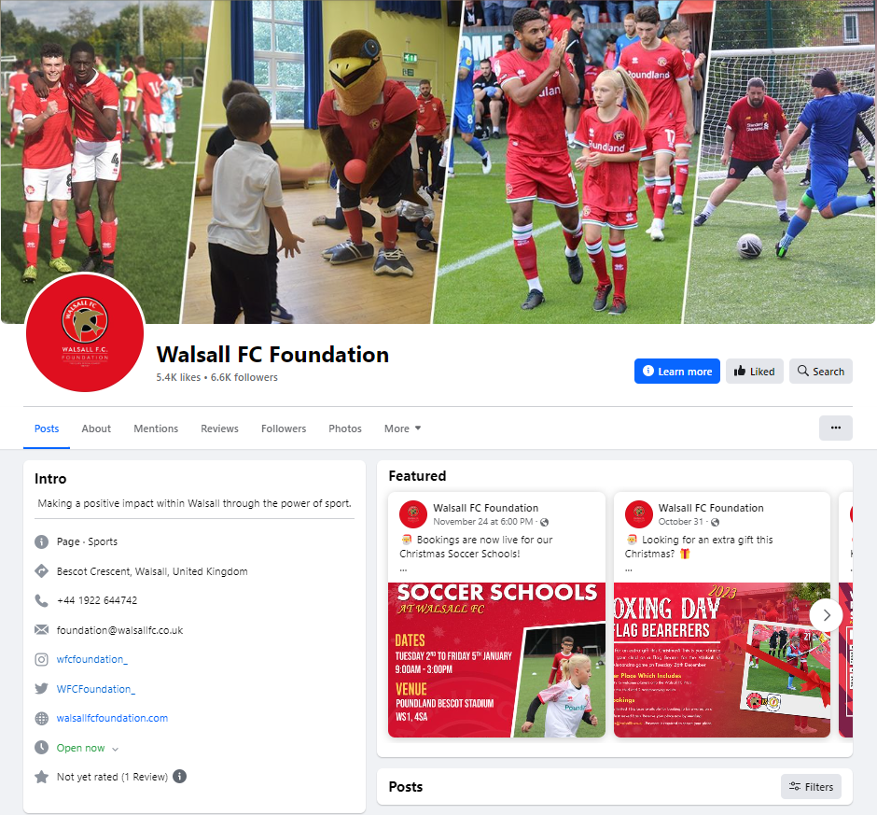
Good Practice Examples – Facebook & Twitter
Consistent header banner for cohesive visual identity
Uniform username across platforms for easy discoverability
Consistent brand colours for a unified look
Transparent display of nonprofit community sports organization status
Direct link to website for enhanced accessibility
Practical information: office directions, contact number with operating hours
Buddle.co
Notes:
https://www.facebook.com/walsallfcfoundation
https://twitter.com/WFCFoundation_

Slide 24
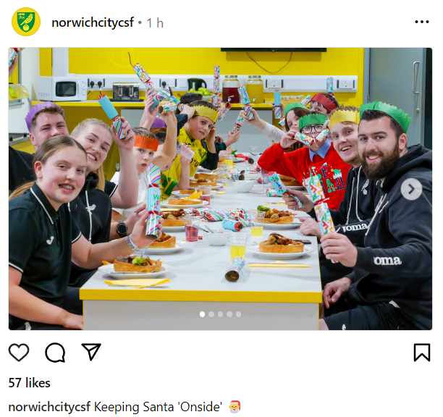
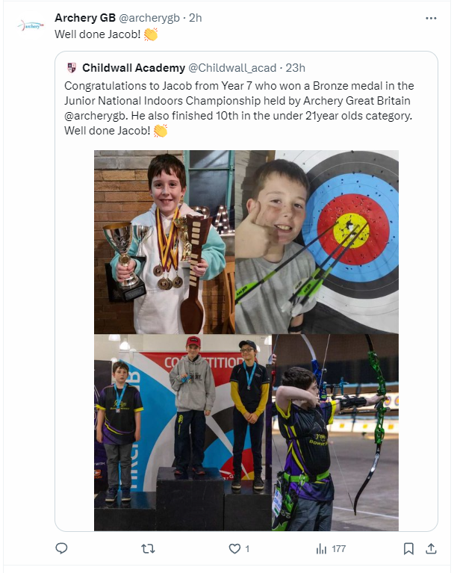
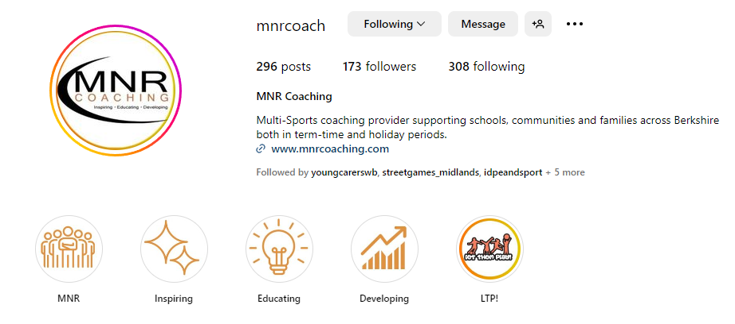
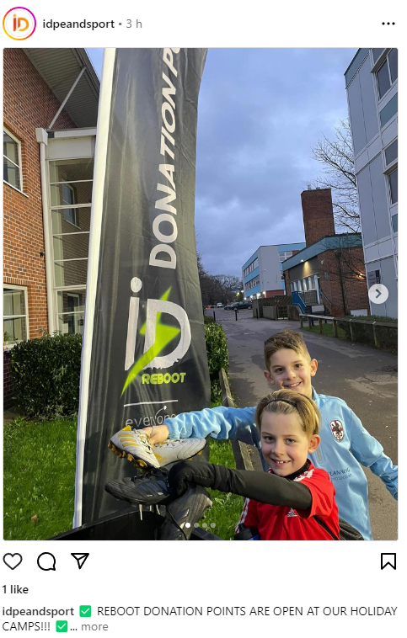
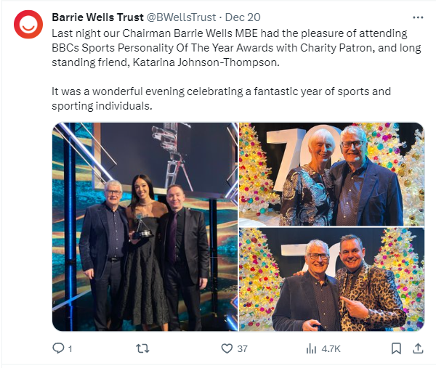
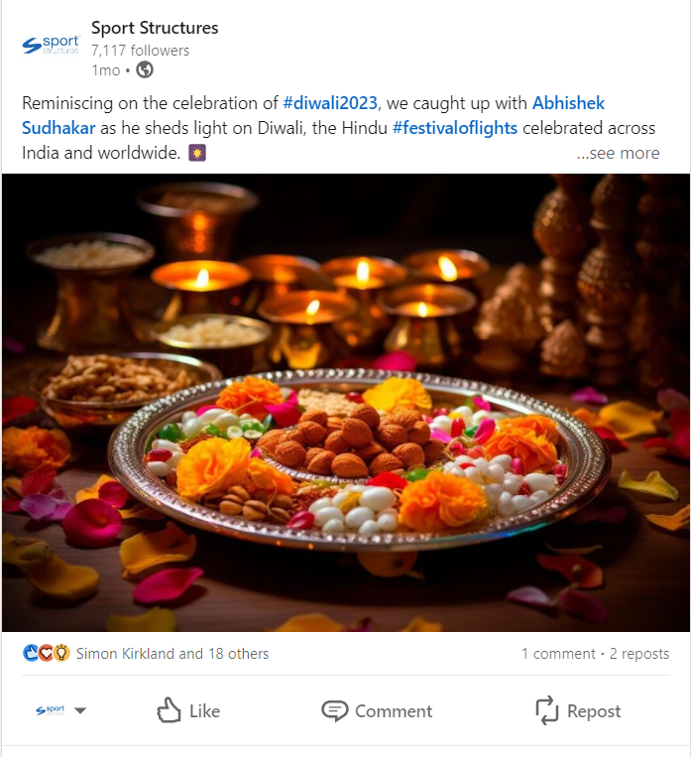
Good Practice Examples
Buddle.co

Slide 25
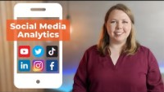
Understanding Social Media and Analytics
Why Analytics are useful:
Measure performance and ROI.
Understand audience preferences.
Identify content trends.
Optimize posting times
Define Clear Goals:
Establish specific, measurable, and achievable goals for your social media efforts.
Examples: Increase brand awareness, drive website traffic, boost engagement, or generate leads.
Buddle.co
Notes:
https://www.youtube.com/watch?v=Z1KJ-16Rfs0

Slide 26
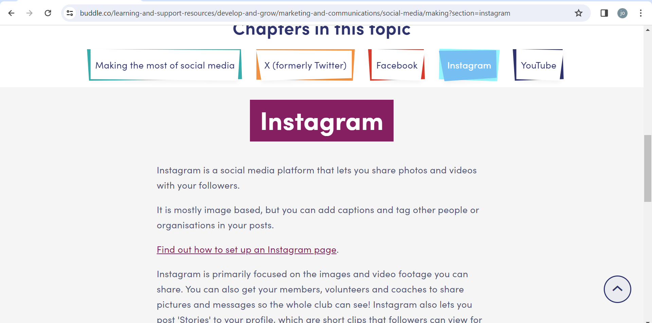
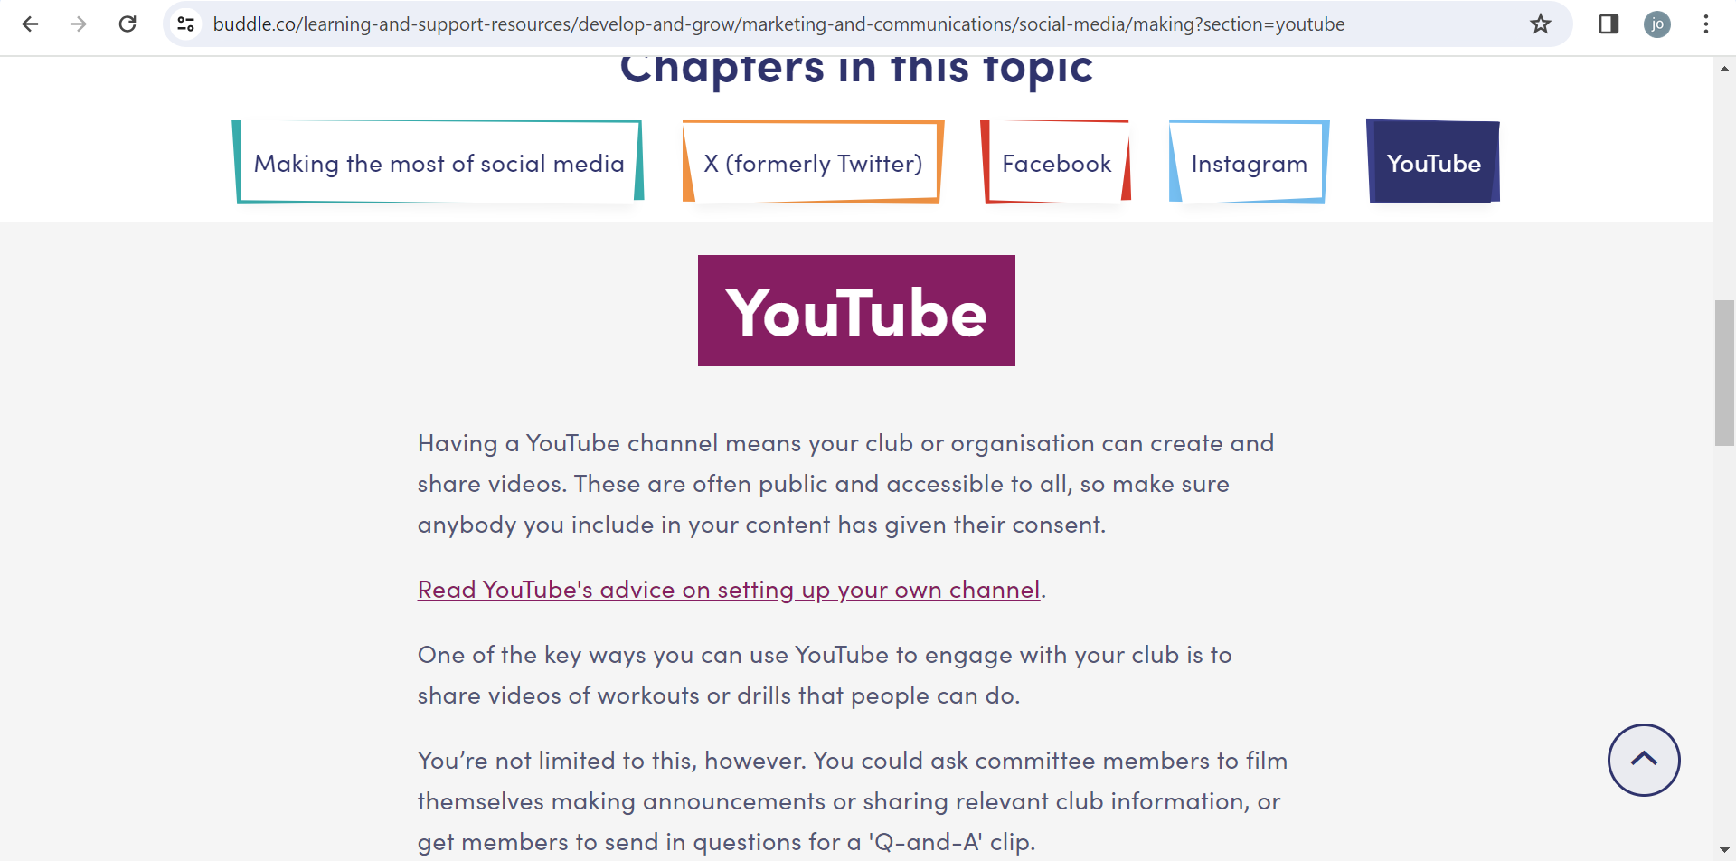
Set up pages on buddle website in develop and grow
Buddle.co

Slide 27


Reflection
What will you take away from this session?
Any questions?
Please complete the evaluation
Good luck!
Buddle.com

Slide 28
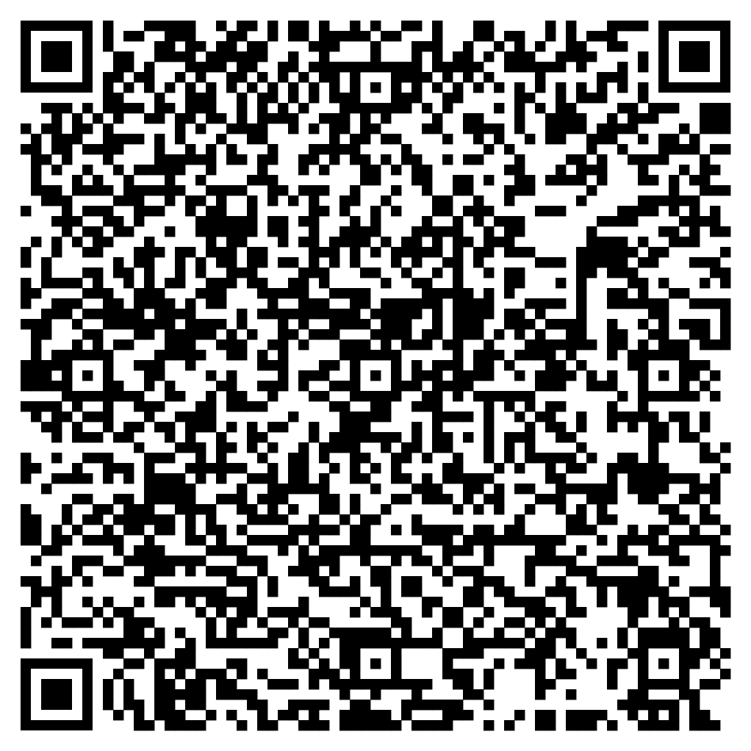





Feedback
Please take the time to fill in the evaluation survey by scanning the QR code.
Alternatively, the tutor will put the link in the chat box for you.
- Thanks in advance, the Buddle Team.

Slide 29
Recap:
By the end of this workshop, you will be able to:
Understand the benefits of using social media in your organisation
Understand how to have a safe social media environment
Considered your brand and ideas for social media
Considered set up and analytics for social media in your organisation
Buddle.com

Slide 30

Buddle training
Getting Organised | Inclusion | Getting Help From People | Money Matters | Develop and Grow
Leadership and Governance | Your Culture and Values In Your Organisation | Maximising Your Volunteers Experience | Raising Money to Sustain Your Organisation | Promoting Your Offer Using Social Media
Exploring Legal Structures | Engaging different People |  | Financial Management | Creating a Marketing Strategy
Future Planning | Positive Experiences For All People |  | Dealing With Increasing Costs | Engaging your community
See future dates at www.buddle.com

Slide 31


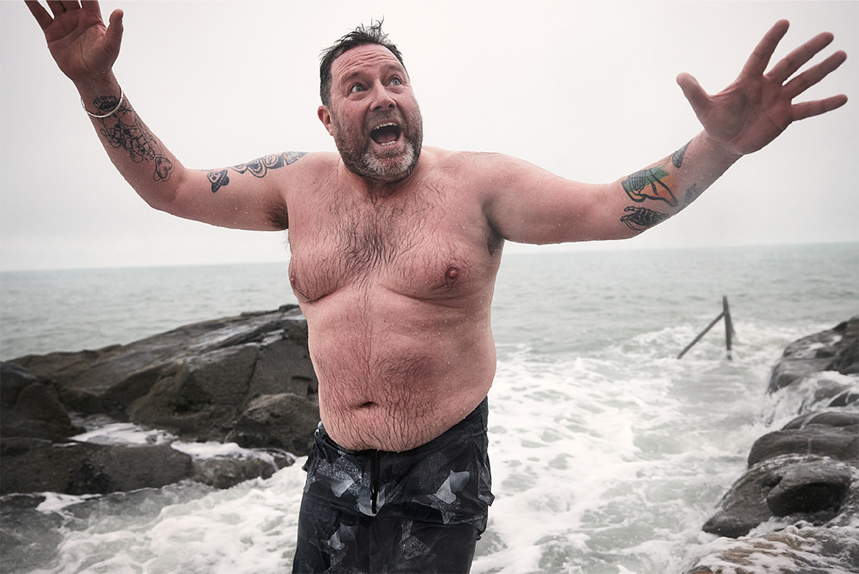
Thank you!
Buddle.com

